Slide 1
Assembling the 1U Frame
Thomas Wu
05/26/2023

Slide 2
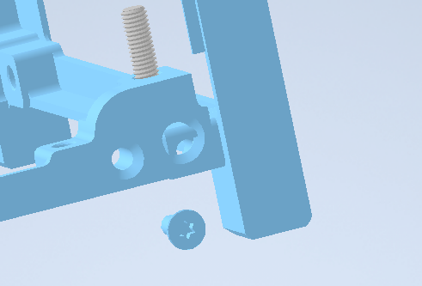
Unscrew the side screws from each corner to remove the side frame

Slide 3
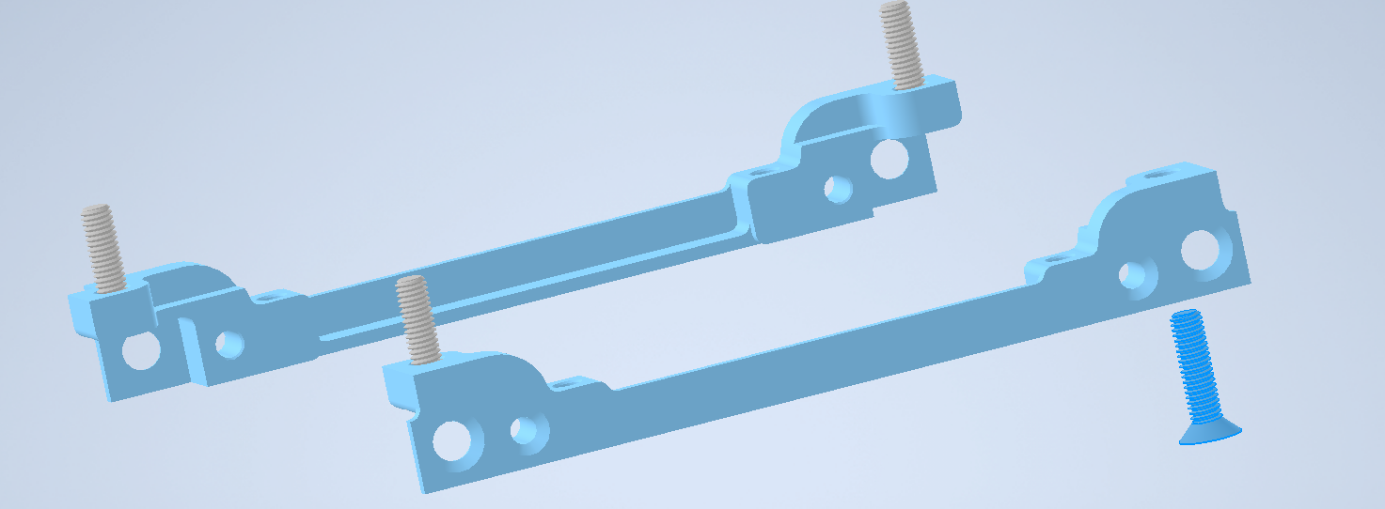
Attach the 4 flat head screws to the bottom frame

Slide 4
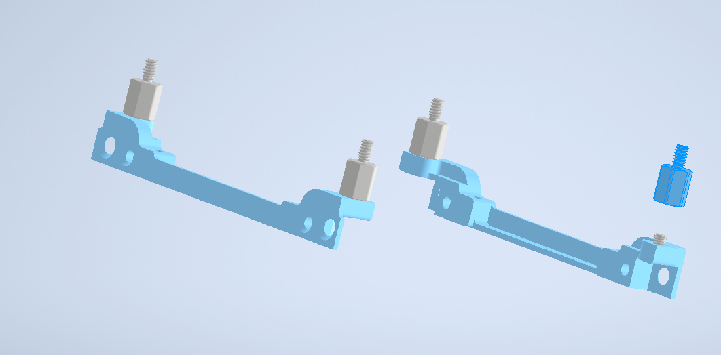
Screw 4 standoffs to the flat head screws

Slide 5
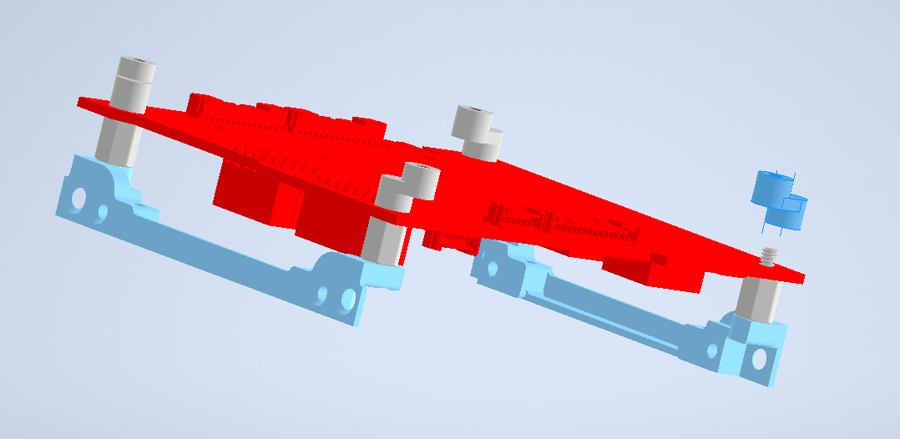
Align the adapter standoffs and power board as shown in the picture (battery will go below the power board)

Slide 6
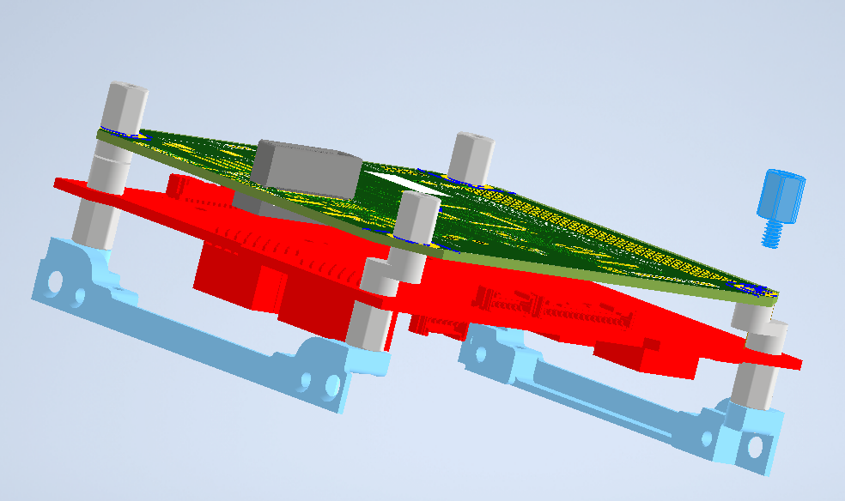
Align LIHU and fasten with 4 standoffs

Slide 7
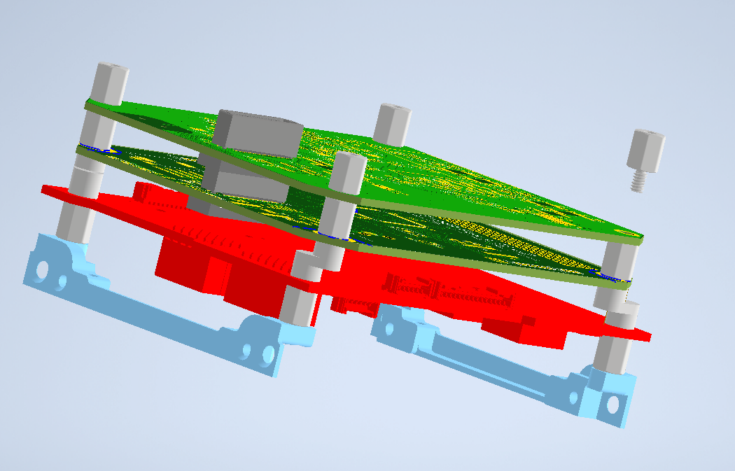
Align LT RT-TX and again fasten with 4 standoffs

Slide 8
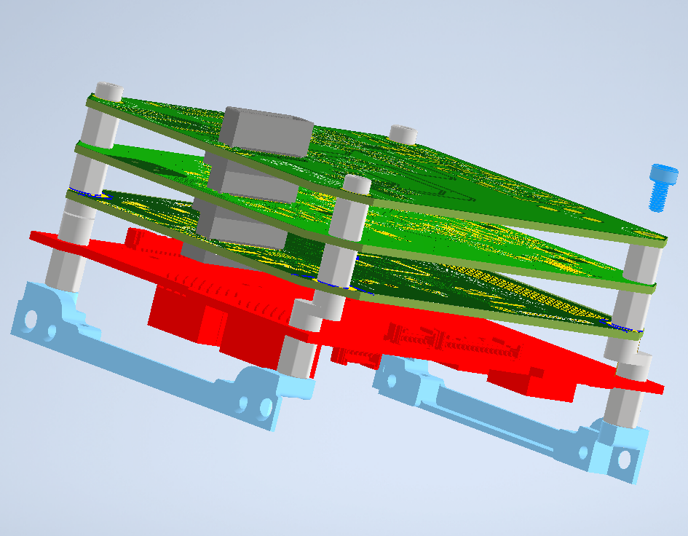
Align LT ICR and fasten with 4 socket head screw

Slide 9
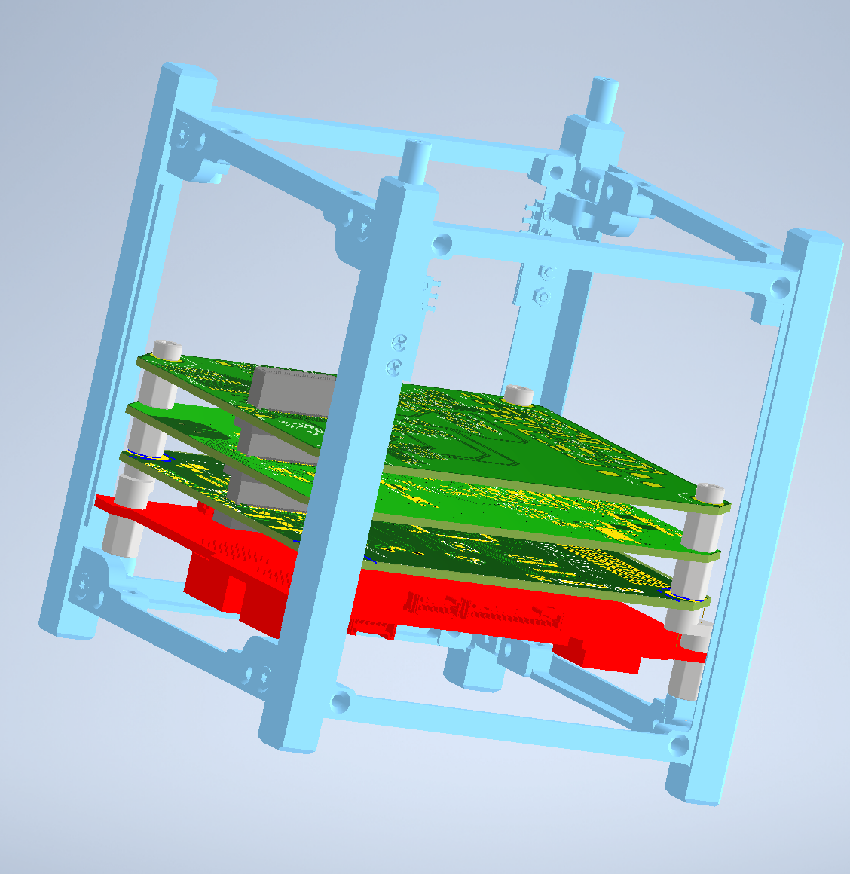
Reattach the side frame and screw in the side screws

Slide 10
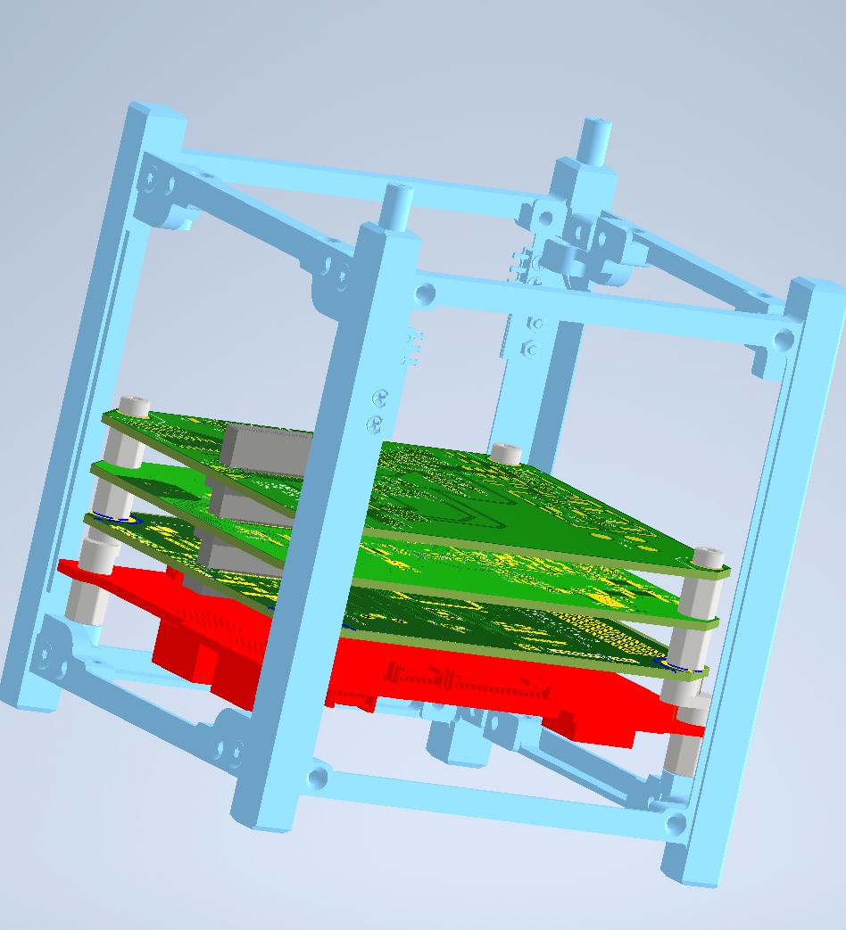
Complete Model

